Slide 1
Introduction to Networking
CT043-3-1 & Version VE1
Protocols and Models

Slide 2
Protocols and Models
Notes:
Cisco Networking Academy Program
Introduction to Networks v7.0 (ITN)
Module 3: Protocols and Models

Slide 4
.
Topic and structure of the Lesson
Topic Title | Topic Objective
The Rules | Describe the types of rules that are necessary to successfully communicate.
Protocols | Explain why protocols are necessary in network communication.
Protocol Suites | Explain the purpose of adhering to a protocol suite.
Standards Organizations | Explain the role of standards organizations in establishing protocols for network interoperability.
Reference Models | Explain how the TCP/IP model and the OSI model are used to facilitate standardization in the communication process.
Data Encapsulation | Explain how data encapsulation allows data to be transported across the network.
Data Access | Explain how local hosts access local resources on a network.
Notes:
<number>
3 – Protocols and Models
3.0 – Introduction
3.0.2 – What will I learn to do in this module?

Slide 5
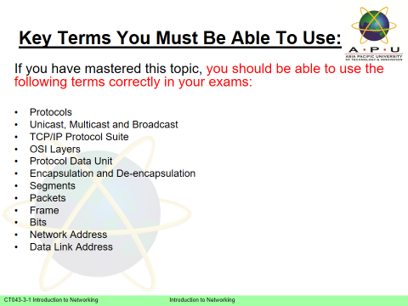

Slide 6
The Rules
Notes:
3 – Protocols and Models
3.1 – The Rules

Slide 7
The Rules Communications Fundamentals
Networks can vary in size and complexity. It is not enough to have a connection, devices must agree on “how” to communicate.
There are three elements to any communication:
There will be a source (sender).
There will be a destination (receiver).
There will be a channel (media) that provides for the path of communications to occur.
Notes:
3 – Protocols and Models
3.1 – The Rules
3.1.2 –Communications Fundamentals

Slide 8
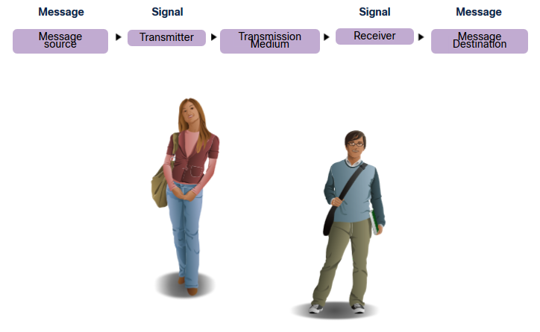
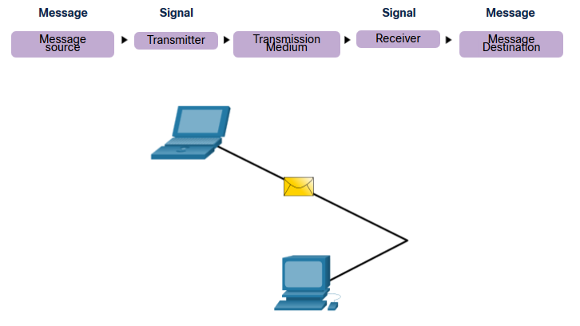
The Rules Communications Protocols
All communications are governed by protocols.
Protocols are the rules that communications will follow.
These rules will vary depending on the protocol.
Notes:
3 – Protocols and Models
3.1 – The Rules
3.1.3 – Communications Protocols

Slide 9
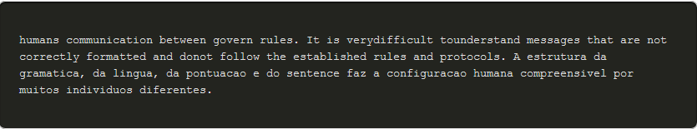
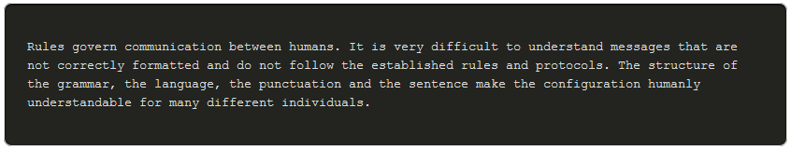
The Rules Rule Establishment
Individuals must use established rules or agreements to govern the conversation.
The first message is difficult to read because it is not formatted properly. The second shows the message properly formatted
Notes:
3 – Protocols and Models
3.1 – The Rules
3.1.4 – Rules Establishment

Slide 10
The Rules Rule Establishment (Cont.)
Protocols must account for the following requirements:
An identified sender and receiver
Common language and grammar
Speed and timing of delivery
Confirmation or acknowledgment requirements
Notes:
3 – Protocols and Models
3.1 – The Rules
3.1.4 – Rules Establishment (Cont.)

Slide 11
The Rules Network Protocol Requirements
Common computer protocols must be in agreement and include the following requirements:
Message encoding
Message formatting and encapsulation
Message size
Message timing
Message delivery options
Notes:
3 – Protocols and Models
3.1 – The Rules
3.1.5 – Network Protocol Requirements

Slide 12
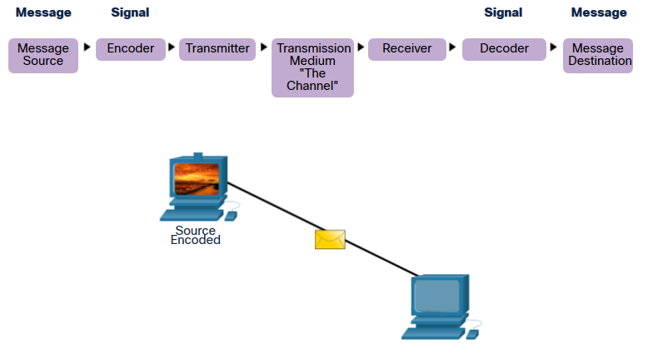
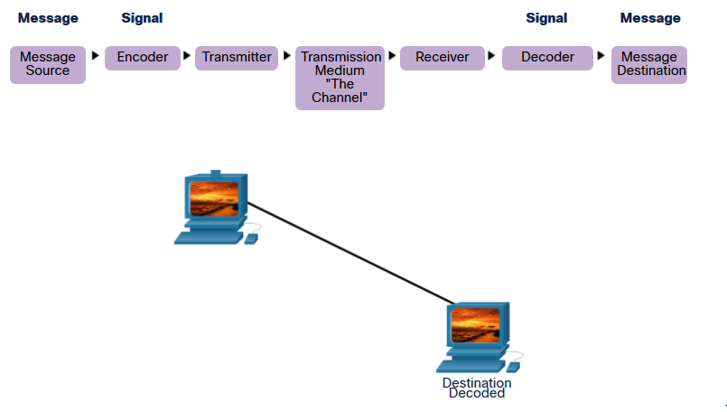
The Rules Message Encoding
Encoding is the process of converting information into another acceptable form for transmission.
Decoding reverses this process to interpret the information.
Notes:
Messages sent across the network are first converted into bits by the sending host. Each bit is encoded into a pattern of voltages on copper wires, infrared light in optical fibers, or microwaves for wireless systems. The destination host receives and decodes the signals to interpret the message.
3 – Protocols and Models
3.1 – The Rules
3.1.6 – Message Encoding

Slide 13
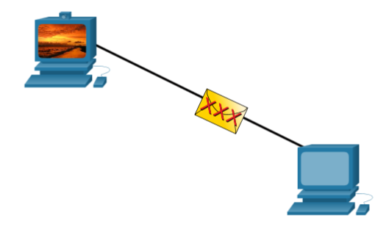
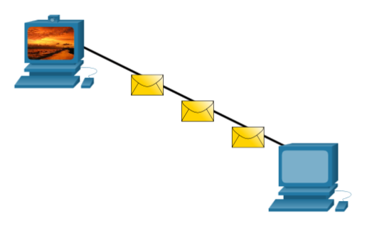
The Rules Message Encoding
Encoding between hosts must be in an appropriate format for the medium.
Messages sent across the network are converted to bits
The bits are encoded into a pattern of light, sound, or electrical impulses.
The destination host must decode the signals to interpret the message.
Notes:
Messages sent across the network are first converted into bits by the sending host. Each bit is encoded into a pattern of voltages on copper wires, infrared light in optical fibers, or microwaves for wireless systems. The destination host receives and decodes the signals to interpret the message.
3 – Protocols and Models
3.1 – The Rules
3.1.8 – Message Size

Slide 14
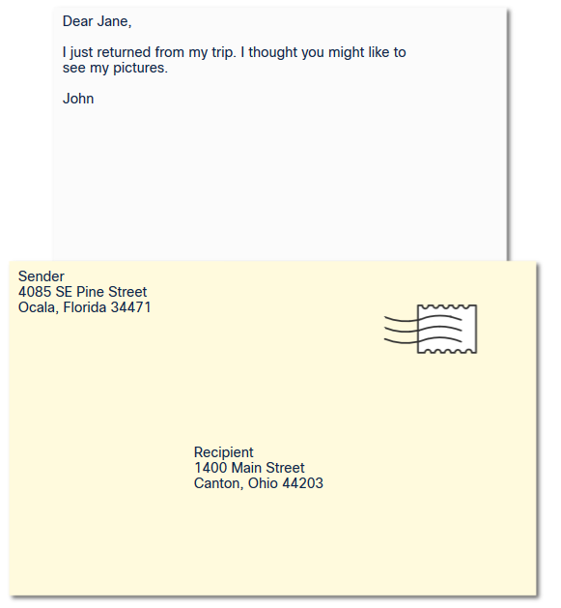
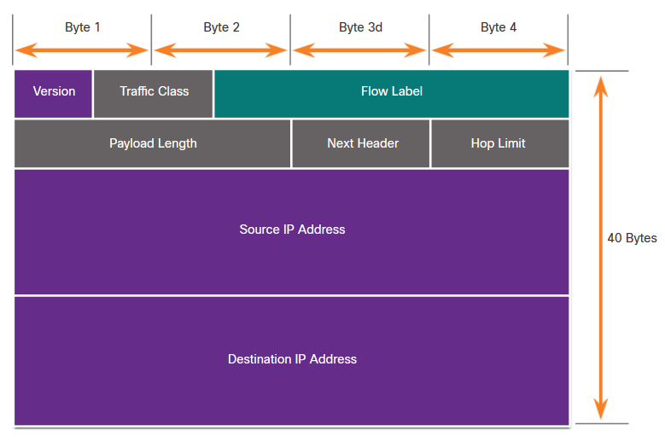
The Rules Message Formatting and Encapsulation
When a message is sent, it must use a specific format or structure.
Message formats depend on the type of message and the channel that is used to deliver the message.
Notes:
3 – Protocols and Models
3.1 – The Rules
3.1.7 – Message Formatting and Encapsulation

Slide 15
The Rules Message Size
when a long message is sent from one host to another over a network, it is necessary to break the message into smaller pieces (packets).
Notes:
3 – Protocols and Models
3.1 – The Rules
3.1.8 – Message Size

Slide 16
The Rules Message Timing
Message timing includes the following:
Flow Control – Manages the rate of data transmission and defines how much information can be sent and the speed at which it can be delivered.
Response Timeout – Manages how long a device waits when it does not hear a reply from the destination.
Access method - Determines when someone can send a message.
There may be various rules governing issues like “collisions”. This is when more than one device sends traffic at the same time and the messages become corrupt.
Some protocols are proactive and attempt to prevent collisions; other protocols are reactive and establish a recovery method after the collision occurs.
Notes:
3 – Protocols and Models
3.1 – The Rules
3.1.9 – Message Timing

Slide 17
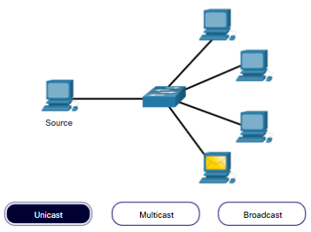
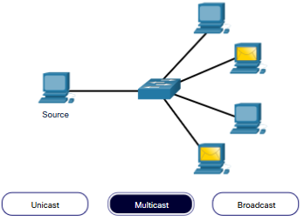
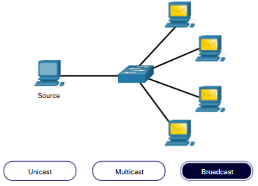
The Rules Message Delivery Options
Message delivery may one of the following methods:
Unicast – one to one communication
Multicast – one to many, typically not all
Broadcast – one to all
Note: Broadcasts are used in IPv4 networks, but are not an option for IPv6. Later we will also see “Anycast” as an additional delivery option for IPv6.
Notes:
3 – Protocols and Models
3.1 – The Rules
3.1.10 – Message Delivery Options

Slide 18
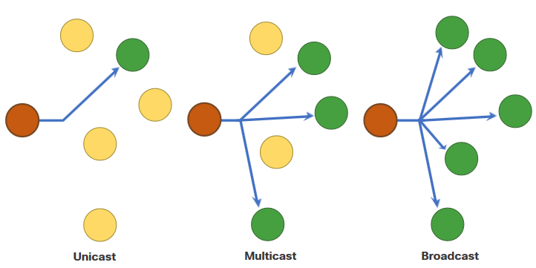
The Rules A Note About the Node Icon
Documents may use the node icon , typically a circle, to represent all devices.
The figure illustrates the use of the node icon for delivery options.
Notes:
3 – Protocols and Models
3.1 – The Rules
3.1.11 – A Note About the Node Icon
3.1.12 – Check Your Understanding – The Rules

Slide 19
Protocols
Notes:
3 – Protocols and Models
3.2 – Protocols

Slide 20
Protocols Network Protocol Overview
Network protocols define a common set of rules.
Can be implemented on devices in:
Software
Hardware
Both
Protocols have their own:
Function
Format
Rules
Protocol Type | Description
Network Communications | enable two or more devices to communicate over one or more networks
Network Security | secure data to provide authentication, data integrity, and data encryption
Routing | enable routers to exchange route information, compare path information, and select best path
Service Discovery | used for the automatic detection of devices or services
Notes:
3 – Protocols and Models
3.2 – Protocols
3.2.1 – Network Protocol Overview

Slide 21
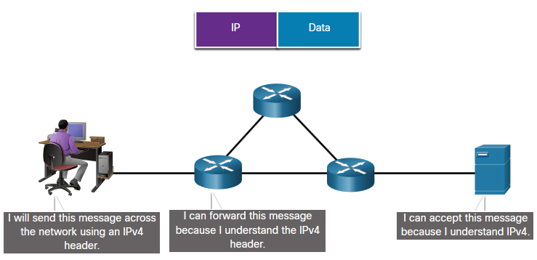
Protocols Network Protocol Functions
Devices use agreed-upon protocols to communicate .
Protocols may have one or more functions.
Function | Description
Addressing | Identifies sender and receiver
Reliability | Provides guaranteed delivery
Flow Control | Ensures data flows at an efficient rate
Sequencing | Uniquely labels each transmitted segment of data
Error Detection | Determines if data became corrupted during transmission
Application Interface | Process-to-process communications between network applications
Notes:
3 – Protocols and Models
3.2 – Protocols
3.2.2 – Network Protocol Functions

Slide 22
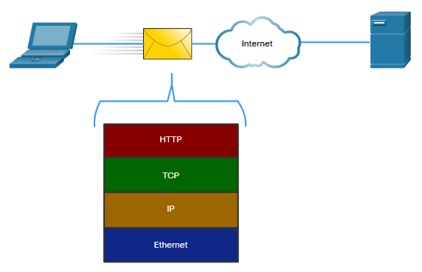
Protocols Protocol Interaction
When we use network, we require the use of several protocols.
Each protocol has its own function and format.
Protocol | Function
Hypertext Transfer Protocol (HTTP) | Governs the way a web server and a web client interact Defines content and format
Transmission Control Protocol (TCP) | Manages the individual conversations Provides guaranteed delivery Manages flow control
Internet Protocol (IP) | Delivers messages globally from the sender to the receiver
Ethernet | Delivers messages from one NIC to another NIC on the same Ethernet Local Area Network (LAN)
Notes:
3 – Protocols and Models
3.2 – Protocols
3.2.3 – Protocol Interaction
3.2.4 – Check Your Understanding - Protocols

Slide 23
Protocol Suites
Notes:
3 – Protocols and Models
3.3 – Protocol Suites

Slide 24
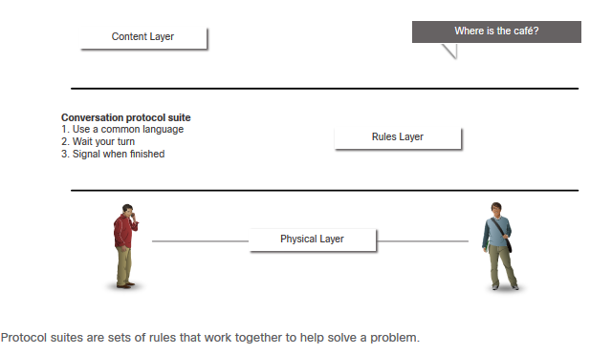
Protocol Suites Network Protocol Suites
Protocols must be able to work with other protocols.
Protocol suite:
A group of inter-related protocols necessary to perform a communication function
Sets of rules that work together to help solve a problem
The protocols are viewed in terms of layers:
Higher Layers
Lower Layers- concerned with moving data and provide services to upper layers
Notes:
3 – Protocols and Models
3.3 – Protocol Suites
3.3.1 – Network Protocol Suites

Slide 25
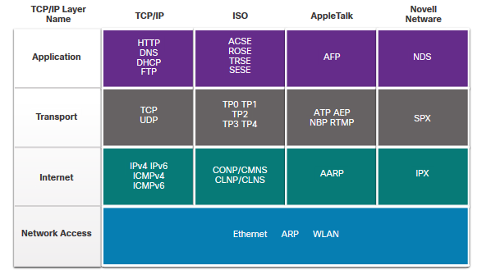
Protocol Suites Evolution of Protocol Suites
There are several protocol suites.
Internet Protocol Suite or TCP/IP- The most common protocol suite and maintained by the Internet Engineering Task Force (IETF)
Open Systems Interconnection (OSI) protocols- Developed by the International Organization for Standardization (ISO) and the International Telecommunications Union (ITU)
AppleTalk- Proprietary suite release by Apple Inc.
Novell NetWare- Proprietary suite developed by Novell Inc.
Notes:
Rules in driving, now all set together under one booklet, we can think of that as the protocol suite
3 – Protocols and Models
3.3 – Protocol Suites
3.3.2 – Evolution of Protocol Suites

Slide 26
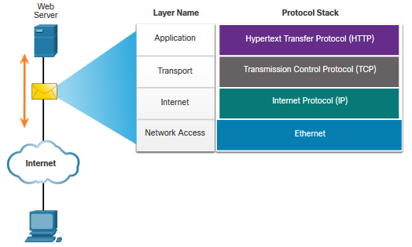
Protocol Suites TCP/IP Protocol Example
TCP/IP protocols operate at the application, transport, and internet layers.
The most common network access layer LAN protocols are Ethernet and WLAN (wireless LAN).
Notes:
3 – Protocols and Models
3.3 – Protocol Suites
3.3.3 – TCP/IP Protocol Example

Slide 27
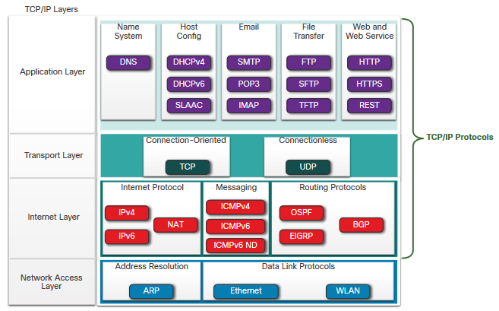
Protocol Suites TCP/IP Protocol Suite
TCP/IP is the protocol suite used by the internet and includes many protocols.
TCP/IP is:
An open standard protocol suite that is freely available to the public and can be used by any vendor
A standards-based protocol suite that is endorsed by the networking industry and approved by a standards organization to ensure interoperability
Notes:
3 – Protocols and Models
3.3 – Protocol Suites
3.3.4 – TCP/IP Protocol Suite

Slide 28
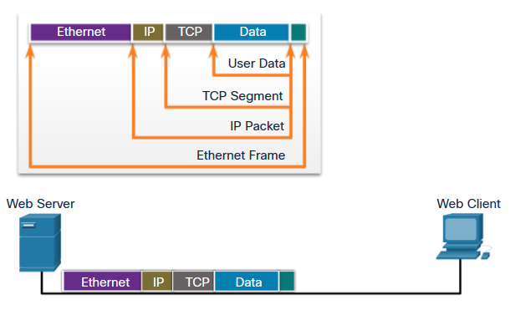
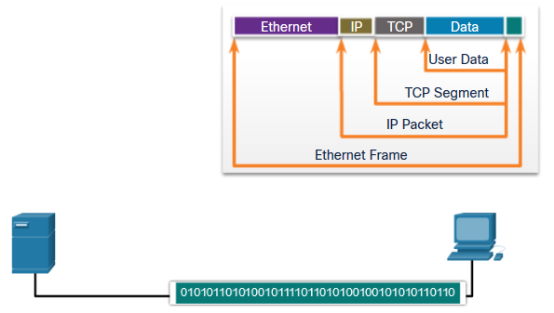
Protocol Suites TCP/IP Communication Process
A web server encapsulating and sending a web page to a client.
A client de-encapsulating the web page for the web browser
Notes:
Each layer is related to each other as they take upper level data and add extra information: encapsulation
3 – Protocols and Models
3.3 – Protocol Suites
3.3.5 – TCP/IP Communication Process
3.3.6 – Check Your Understanding – Protocol Suites

Slide 29
Standards Organizations
Notes:
3 – Protocols and Models
3.4 – Standards Organizations

Slide 30
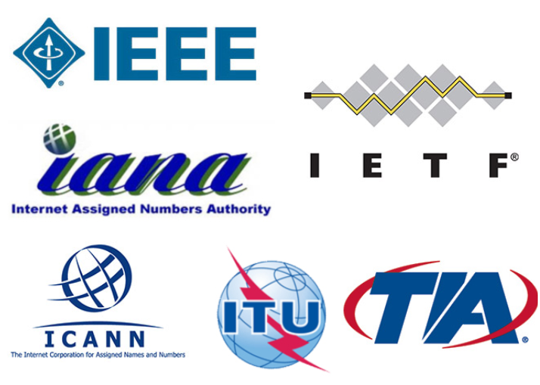
Standards Organizations Open Standards
Open standards encourage:
interoperability
competition
innovation
Standards organizations are:
vendor-neutral
non-profit organizations
established to develop and promote the concept of open standards.
Notes:
3 – Protocols and Models
3.4 – Standards Organizations
3.4.1 – Open Standards

Slide 31
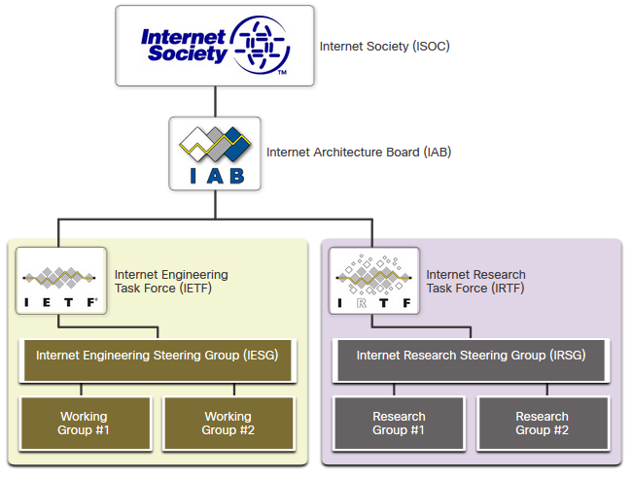
Standards Organizations Internet Standards
Internet Society (ISOC) - Promotes the open development and evolution of internet
Internet Architecture Board (IAB) - Responsible for management and development of internet standards
Internet Engineering Task Force (IETF) - Develops, updates, and maintains internet and TCP/IP technologies
Internet Research Task Force (IRTF) - Focused on long-term research related to internet and TCP/IP protocols
Notes:
3 – Protocols and Models
3.4 – Standards Organizations
3.4.2 – Internet Standards

Slide 32
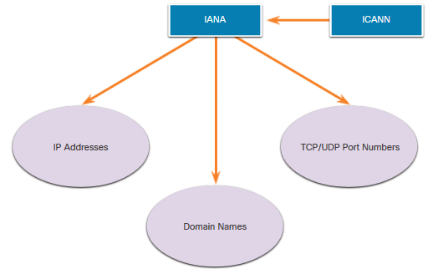
Standards Organizations Internet Standards (Cont.)
Standards organizations involved with the development and support of TCP/IP
Internet Corporation for Assigned Names and Numbers (ICANN) - Coordinates IP address allocation, the management of domain names, and assignment of other information
Internet Assigned Numbers Authority (IANA) - Oversees and manages IP address allocation, domain name management, and protocol identifiers for ICANN
Notes:
3 – Protocols and Models
3.4 – Standards Organizations
3.4.2 – Internet Standards (Cont.)

Slide 33
Standards Organizations Electronic and Communications Standards
Institute of Electrical and Electronics Engineers (IEEE, pronounced “I-triple-E”) - dedicated to creating standards in power and energy, healthcare, telecommunications, and networking
Electronic Industries Alliance (EIA) - develops standards relating to electrical wiring, connectors, and the 19-inch racks used to mount networking equipment
Telecommunications Industry Association (TIA) - develops communication standards in radio equipment, cellular towers, Voice over IP (VoIP) devices, satellite communications, and more
International Telecommunications Union-Telecommunication Standardization Sector (ITU-T) - defines standards for video compression, Internet Protocol Television (IPTV), and broadband communications, such as a digital subscriber line (DSL)
Notes:
3 – Protocols and Models
3.4 – Standards Organizations
3.4.3 – Electronic and Communications Standards

Slide 34
Reference Models
Notes:
3 – Protocols and Models
3.5 – Reference Models

Slide 35
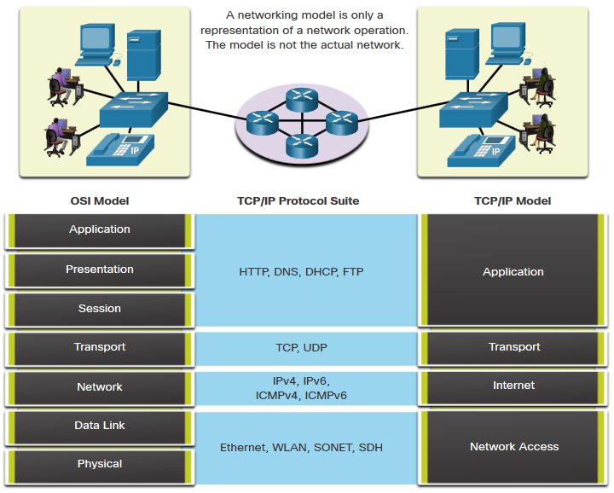
Reference Models The Benefits of Using a Layered Model
Complex concepts such as how a network operates can be difficult to explain and understand. For this reason, a layered model is used.
Two layered models describe network operations:
Open System Interconnection (OSI) Reference Model
TCP/IP Reference Model
Notes:
3 – Protocols and Models
3.5 – Reference Models
3.5.1 – The Benefits of Using a Layered Model

Slide 36
Reference Models The Benefits of Using a Layered Model (Cont.)
These are the benefits of using a layered model:
Assist in protocol design because protocols that operate at a specific layer have defined information that they act upon and a defined interface to the layers above and below
Foster competition because products from different vendors can work together
Prevent technology or capability changes in one layer from affecting other layers above and below
Provide a common language to describe networking functions and capabilities
Notes:
3 – Protocols and Models
3.5 – Reference Models
3.5.1 – The Benefits of Using a Layered Model (Cont.)

Slide 37
Reference Models The OSI Reference Model
OSI Model Layer | Description
7 - Application | Contains protocols used for process-to-process communications.
6 - Presentation | Provides for common representation of the data transferred between application layer services.
5 - Session | Provides services to the presentation layer and to manage data exchange.
4 - Transport | Defines services to segment, transfer, and reassemble the data for individual communications.
3 - Network | Provides services to exchange the individual pieces of data over the network.
2 - Data Link | Describes methods for exchanging data frames over a common media.
1 - Physical | Describes the means to activate, maintain, and de-activate physical connections.
Notes:
3 – Protocols and Models
3.5 – Reference Models
3.5.2 – The OSI Reference Model

Slide 38
Reference Models The TCP/IP Reference Model
TCP/IP Model Layer | Description
Application | Represents data to the user, plus encoding and dialog control.
Transport | Supports communication between various devices across diverse networks.
Internet | Determines the best path through the network.
Network Access | Controls the hardware devices and media that make up the network.
Notes:
3 – Protocols and Models
3.5 – Reference Models
3.5.3 – The TCP/IP Reference Model

Slide 39
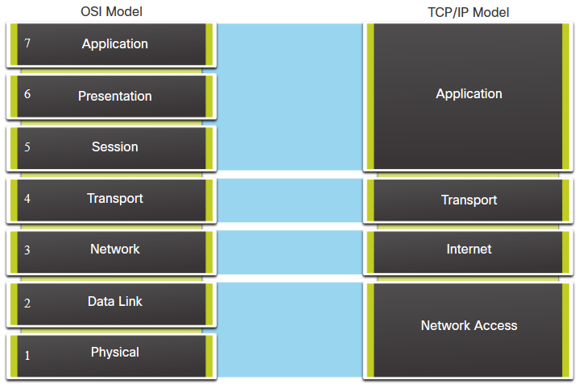
Reference Models OSI and TCP/IP Model Comparison
The OSI model divides the network access layer and the application layer of the TCP/IP model into multiple layers.
The TCP/IP protocol suite does not specify which protocols to use when transmitting over a physical medium.
OSI Layers 1 and 2 discuss the necessary procedures to access the media and the physical means to send data over a network.
Notes:
3 – Protocols and Models
3.5 – Reference Models
3.5.4 – OSI and TCP/IP Model Comparison

Slide 40
Data Encapsulation
Notes:
3 – Protocols and Models
3.6 – Data Encapsulation

Slide 41
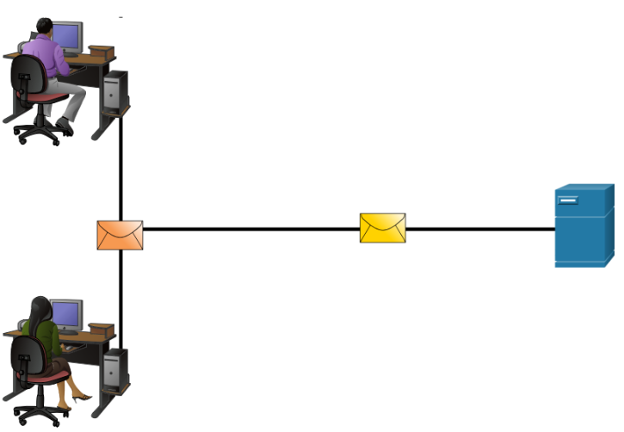
Data Encapsulation Segmenting Messages
Segmenting is the process of breaking up messages into smaller units.
Multiplexing is the processes of taking multiple streams of segmented data and interleaving them together.
Segmenting messages has two primary benefits:
Increases speed - Large amounts of data can be sent over the network without tying up a communications link.
Increases efficiency - Only segments which fail to reach the destination need to be retransmitted, not the entire data stream.
Notes:
3 – Protocols and Models
3.6 – Data Encapsulation
3.6.1 – Segmenting Messages

Slide 42
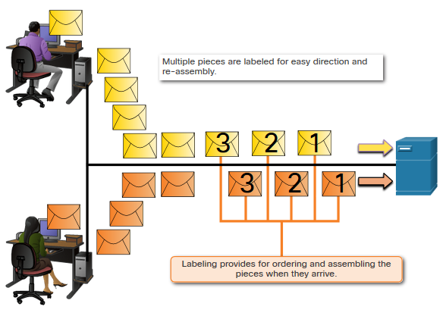
Data Encapsulation Sequencing
Sequencing messages is the process of numbering the segments so that the message may be reassembled at the destination.
TCP is responsible for sequencing the individual segments.
Notes:
3 – Protocols and Models
3.6 – Data Encapsulation
3.6.2 – Sequencing

Slide 43
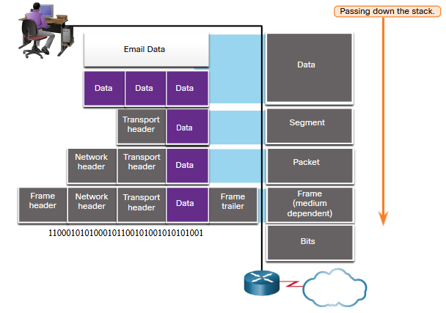
Data Encapsulation Protocol Data Units (PDU)
Encapsulation is the process where protocols add their information to the data.
At each stage of the process, a PDU has a different name to reflect its new functions.
There is no universal naming convention for PDUs, in this course, the PDUs are named according to the protocols of the TCP/IP suite.
PDUs passing down the stack are as follows:
Data (Data Stream)
Segment
Packet
Frame
Bits (Bit Stream)
Notes:
3 – Protocols and Models
3.6 – Data Encapsulation
3.6.3 – Protocol Data Units

Slide 44
Data Encapsulation Encapsulation Example
Encapsulation is a top down process.
The level above does its process and then passes it down to the next level of the model. This process is repeated by each layer until it is sent out as a bit stream.
Notes:
3 – Protocols and Models
3.6 – Data Encapsulation
3.6.4 – Encapsulation Example

Slide 45
Data Encapsulation De-encapsulation Example
Data is de-encapsulated as it moves up the stack.
When a layer completes its process, that layer strips off its header and passes it up to the next level to be processed. This is repeated at each layer until it is a data stream that the application can process.
Received as Bits (Bit Stream)
Frame
Packet
Segment
Data (Data Stream)
Notes:
3 – Protocols and Models
3.6 – Data Encapsulation
3.6.5 – De-encapsulation Example
3.6.6 – Check Your Understanding – Data Encapsulation

Slide 46
Data Access
Notes:
3 – Protocols and Models
3.7 – Data Access

Slide 47
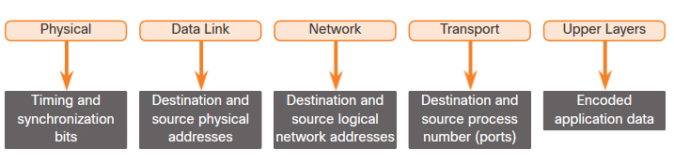
Data Access Addresses
Both the data link and network layers use addressing to deliver data from source to destination.
Network layer source and destination addresses - Responsible for delivering the IP packet from original source to the final destination.
Data link layer source and destination addresses – Responsible for delivering the data link frame from one network interface card (NIC) to another NIC on the same network.
Notes:
3 – Protocols and Models
3.7 – Data Access
3.7.1 – Addresses

Slide 48
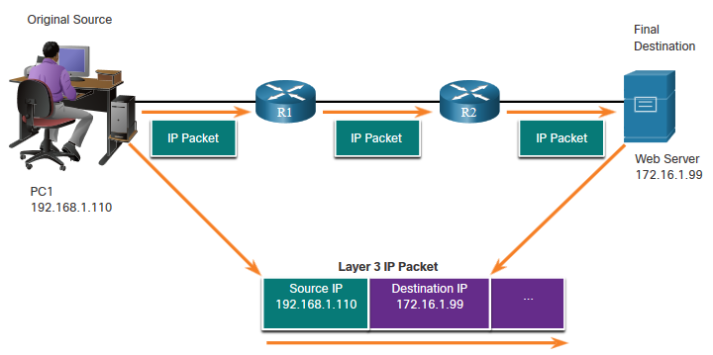
Data Access Layer 3 Logical Address
The IP packet contains two IP addresses:
Source IP address - The IP address of the sending device, original source of the packet.
Destination IP address - The IP address of the receiving device, final destination of the packet.
These addresses may be on the same link or remote.
Notes:
IP : Home address (Global)
3 – Protocols and Models
3.7 – Data Access
3.7.2 – Layer 3 Logical Address

Slide 49
Data Access Layer 3 Logical Address (Cont.)
An IP address contains two parts:
Network portion (IPv4) or Prefix (IPv6)
The left-most part of the address indicates the network group which the IP address is a member.
Each LAN or WAN will have the same network portion.
Host portion (IPv4) or Interface ID (IPv6)
The remaining part of the address identifies a specific device within the group.
This portion is unique for each device on the network.
Notes:
3 – Protocols and Models
3.7 – Data Access
3.7.2 – Layer 3 Logical Address (Cont.)

Slide 50
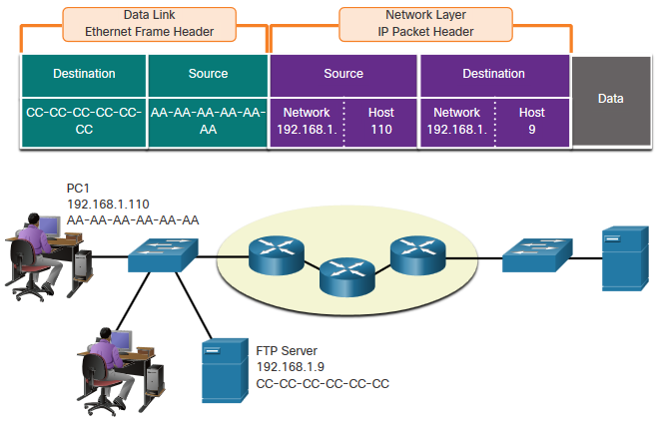
Data Access Devices on the Same Network
When devices are on the same network the source and destination will have the same number in network portion of the address.
PC1 – 192.168.1.110
FTP Server – 192.168.1.9
Notes:
3 – Protocols and Models
3.7 – Data Access
3.7.3 – Devices on the Same Network-

Slide 51
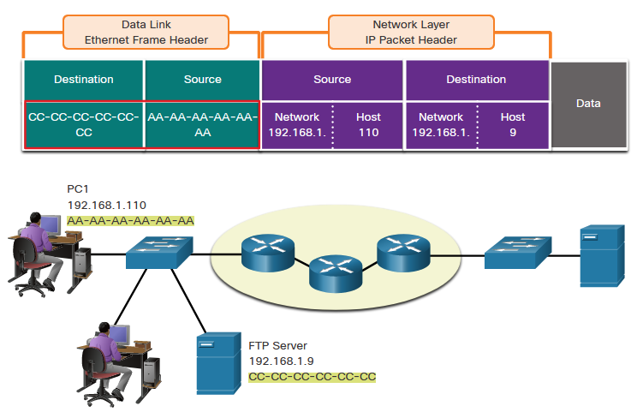
Data Access Role of the Data Link Layer Addresses: Same IP Network
When devices are on the same Ethernet network the data link frame will use the actual MAC address of the destination NIC.
MAC addresses are physically embedded into the Ethernet NIC and are local addressing.
The Source MAC address will be that of the originator on the link.
The Destination MAC address will always be on the same link as the source, even if the ultimate destination is remote.
Notes:
IP : Home address (Global) MAC: Person Name (At Home)
3 – Protocols and Models
3.7 – Data Access
3.7.4 – Role of the Data Link Layer Addresses: Same IP Network

Slide 52
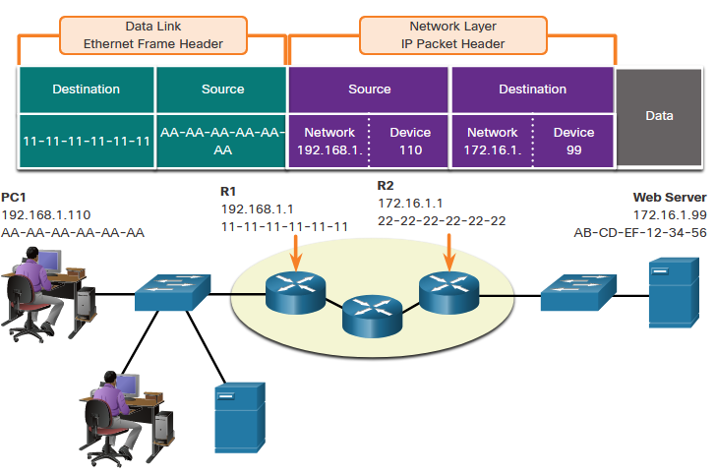
Data Access Devices on a Remote Network
What happens when the actual (ultimate) destination is not on the same LAN and is remote?
What happens when PC1 tries to reach the Web Server?
Does this impact the network and data link layers?
Notes:
3 – Protocols and Models
3.7 – Data Access
3.7.5 – Devices on a Remote Network

Slide 53
Data Access Role of the Network Layer Addresses
When the source and destination have a different network portion, this means they are on different networks.
PC1 – 192.168.1
Web Server – 172.16.1
Notes:
3 – Protocols and Models
3.7 – Data Access
3.7.6 – Role of the Network Layer Addresses

Slide 54
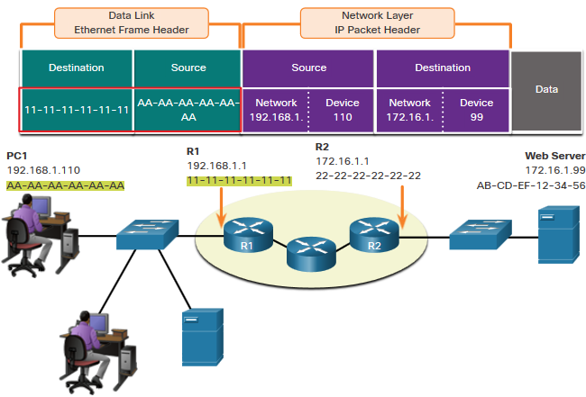
Data Access Role of the Data Link Layer Addresses: Different IP Networks
When the final destination is remote, Layer 3 will provide Layer 2 with the local default gateway IP address, also known as the router address.
The default gateway (DGW) is the router interface IP address that is part of this LAN and will be the “door” or “gateway” to all other remote locations.
All devices on the LAN must be told about this address or their traffic will be confined to the LAN only.
Once Layer 2 on PC1 forwards to the default gateway (Router), the router then can start the routing process of getting the information to actual destination.
Notes:
When Packet is to different network, the IP address will always remain the same
But the MAC address source and destination changes from one hop to another hop (Parcel from Japan to Malaysia, hub by hub)
3 – Protocols and Models
3.7 – Data Access
3.7.7 – Role of the Data Link Layer Addresses: Different IP Networks

Slide 55
Data Access Role of the Data Link Layer Addresses: Different IP Networks (Cont.)
The data link addressing is local addressing so it will have a source and destination for each link.
The MAC addressing for the first segment is :
Source – AA-AA-AA-AA-AA-AA (PC1) Sends the frame.
Destination – 11-11-11-11-11-11 (R1- Default Gateway MAC) Receives the frame.
Note: While the L2 local addressing will change from link to link or hop to hop, the L3 addressing remains the same.
Notes:
3 – Protocols and Models
3.7 – Data Access
3.7.7 – Role of the Data Link Layer Addresses: Different IP Networks (Cont.)

Slide 56
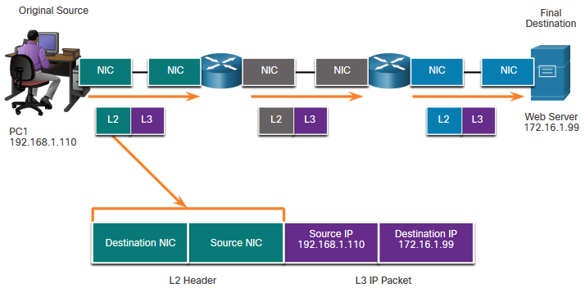
Data Access Data Link Addresses
Since data link addressing is local addressing, it will have a source and destination for each segment or hop of the journey to the destination.
The MAC addressing for the first segment is:
Source – (PC1 NIC) sends frame
Destination – (First Router- DGW interface) receives frame
Notes:
3 – Protocols and Models
3.7 – Data Access
3.7.8 – Data Link Addresses

Slide 57
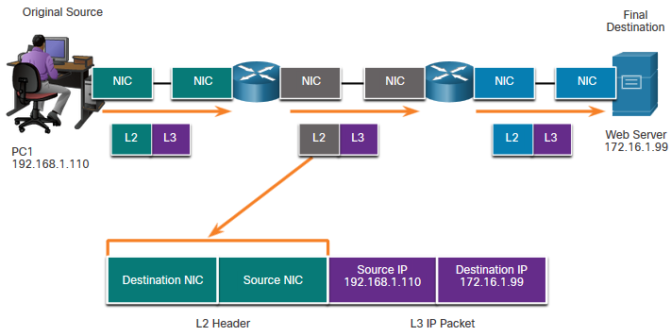
Data Access Data Link Addresses (Cont.)
The MAC addressing for the second hop is:
Source – (First Router- exit interface) sends frame
Destination – (Second Router) receives frame
Notes:
3 – Protocols and Models
3.7 – Data Access
3.7.8 – Data Link Addresses (Cont.)

Slide 58
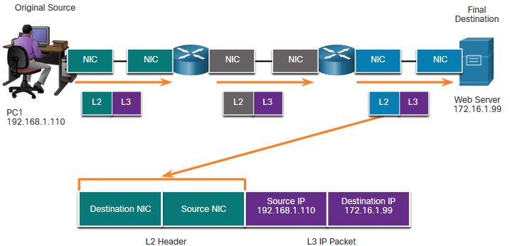
Data Access Data Link Addresses (Cont.)
The MAC addressing for the last segment is:
Source – (Second Router- exit interface) sends frame
Destination – (Web Server NIC) receives frame
Notes:
3 – Protocols and Models
3.7 – Data Access
3.7.8 – Data Link Addresses (Cont.)

Slide 59
Data Access Data Link Addresses (Cont.)
Notice that the packet is not modified, but the frame is changed, therefore the L3 IP addressing does not change from segment to segment like the L2 MAC addressing.
The L3 addressing remains the same since it is global and the ultimate destination is still the Web Server.
Notes:
3 – Protocols and Models
3.7 – Data Access
3.7.8 – Data Link Addresses (Cont.)

Slide 60
.
https://www.youtube.com/watch?v=xaKvGnnuYmk

Slide 61
Summary
Notes:
4-Physical Layer
4.8 - Summary

Slide 62
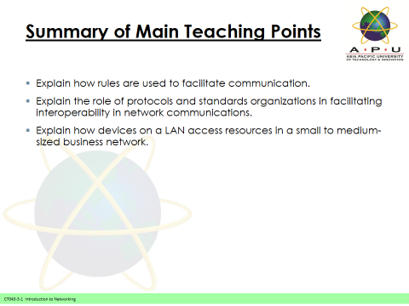
Summary / Recap of Main Points

Slide 63
Q & A

Slide 64
What To Expect Next Week
In Class
Application Layer

